Slide 1
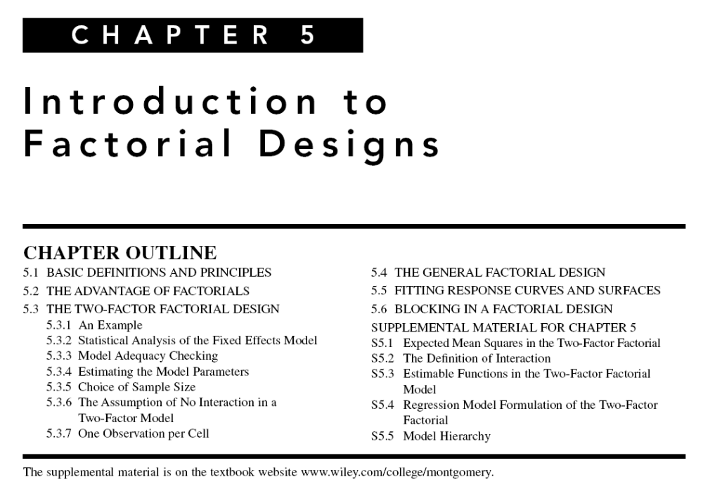

Slide 2
Design of Engineering Experiments
– Introduction to Factorials
Text reference, Chapter 5
General principles of factorial experiments
The two-factor factorial with fixed effects
The ANOVA for factorials
Extensions to more than two factors
Quantitative and qualitative factors – response curves and surfaces

Slide 3
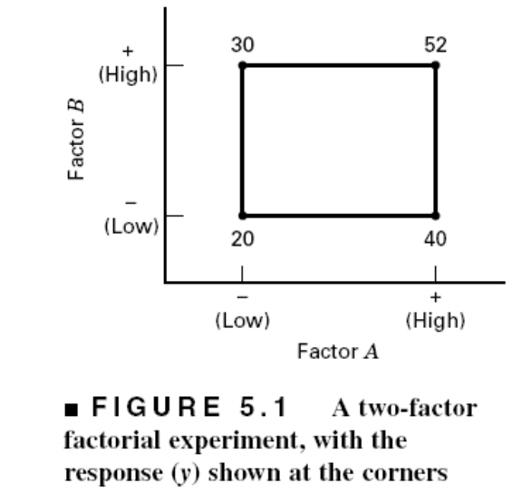
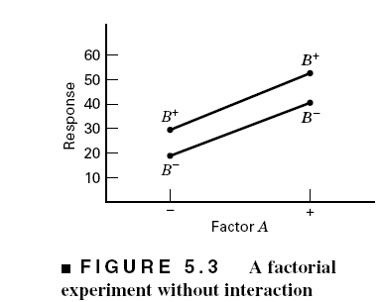
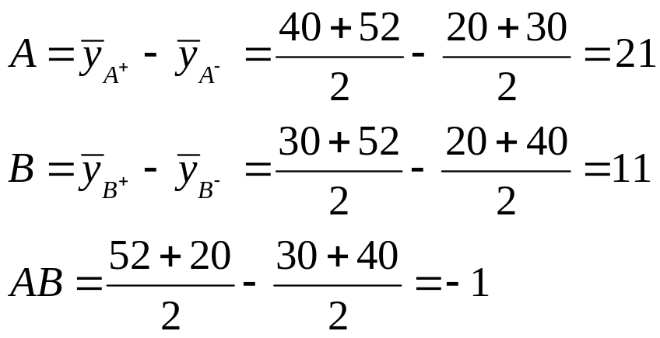
Some Basic Definitions
Definition of a factor effect: The change in the mean response when the factor is changed from low to high

Slide 4
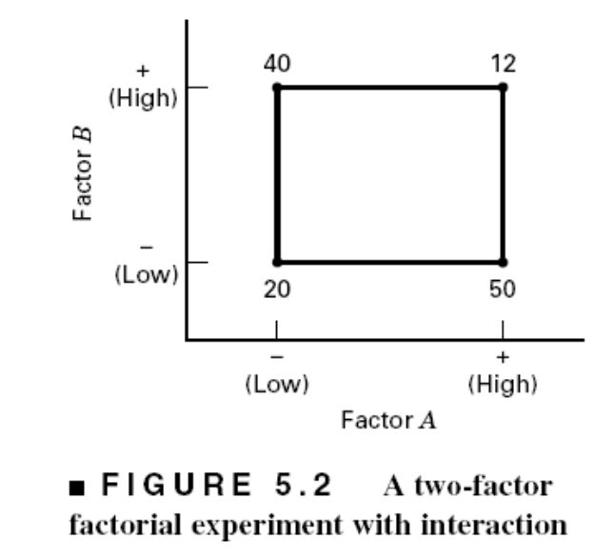
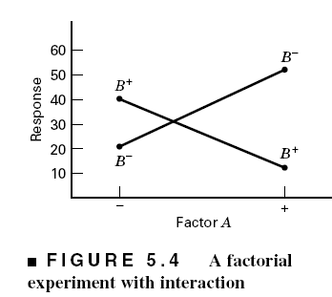
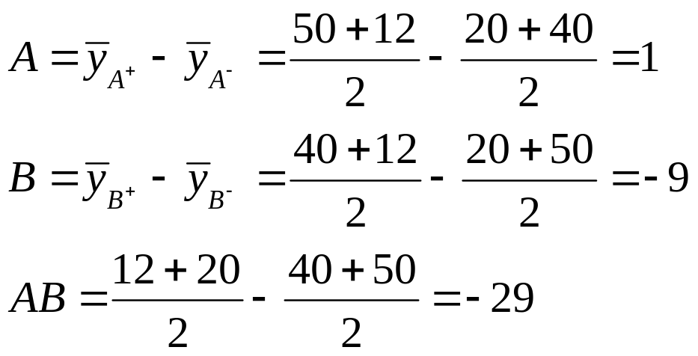
The Case of Interaction:

Slide 5
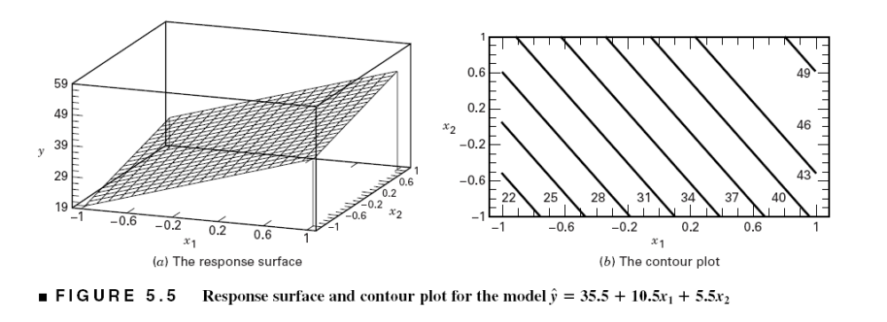
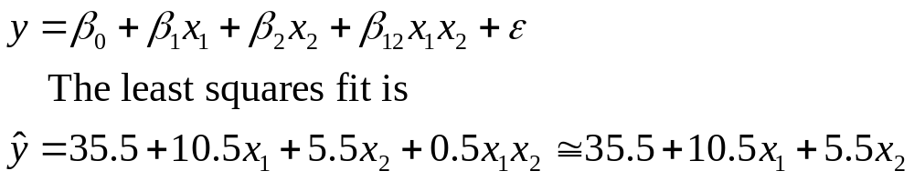
Regression Model & The Associated Response Surface

Slide 6
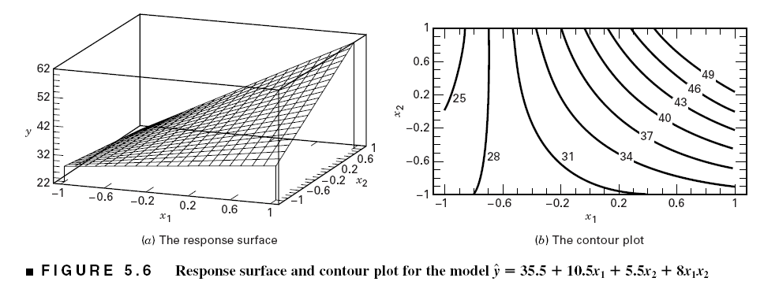
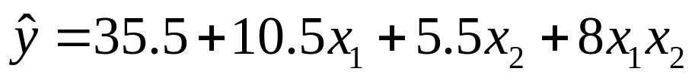
The Effect of Interaction on the Response Surface
Suppose that we add an interaction term to the model:
Interaction is actually a form of curvature

Slide 7
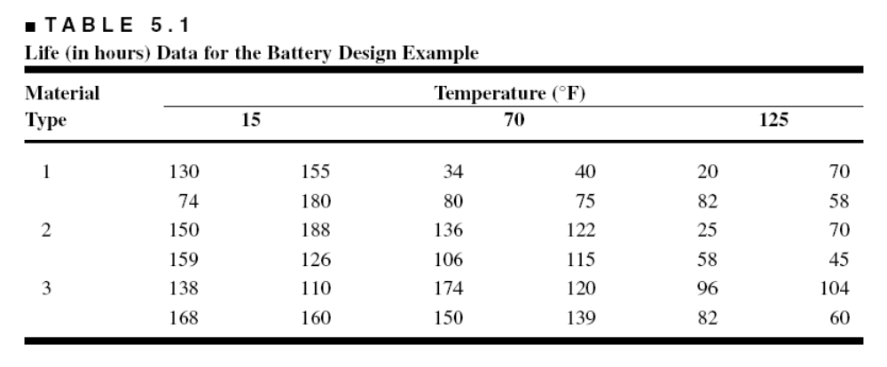
Example 5.1 The Battery Life Experiment
Text reference pg. 167
A = Material type; B = Temperature (A quantitative variable)
What effects do material type & temperature have on life?
2. Is there a choice of material that would give long life regardless of temperature (a robust product)?

Slide 8
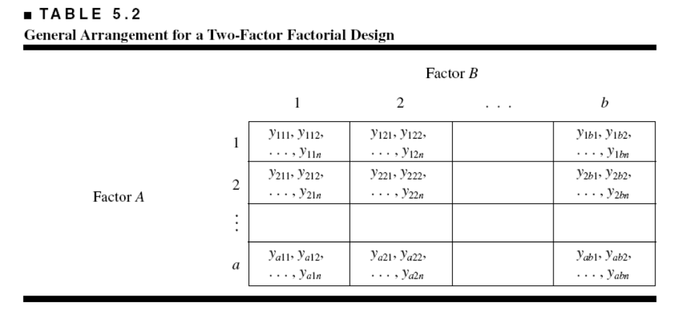
The General Two-Factor
Factorial Experiment
a levels of factor A; b levels of factor B; n replicates
This is a completely randomized design

Slide 9
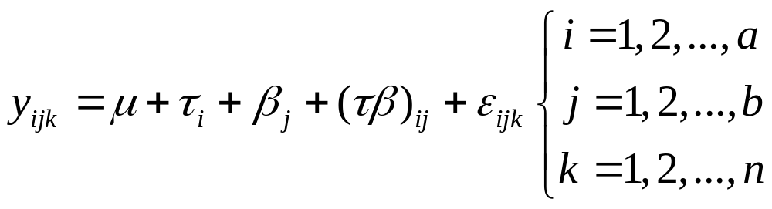
Statistical (effects) model:
Other models (means model, regression models) can be useful

Slide 10
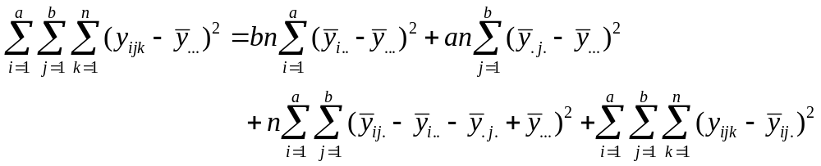
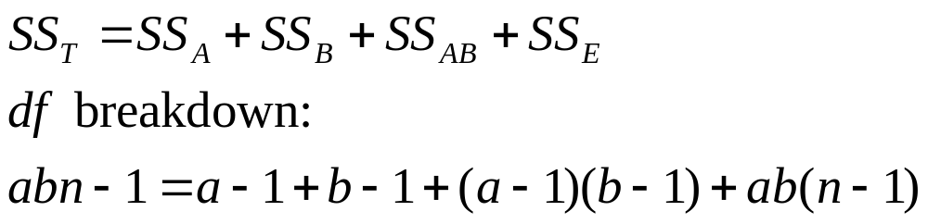
Extension of the ANOVA to Factorials (Fixed Effects Case) – pg. 168

Slide 11
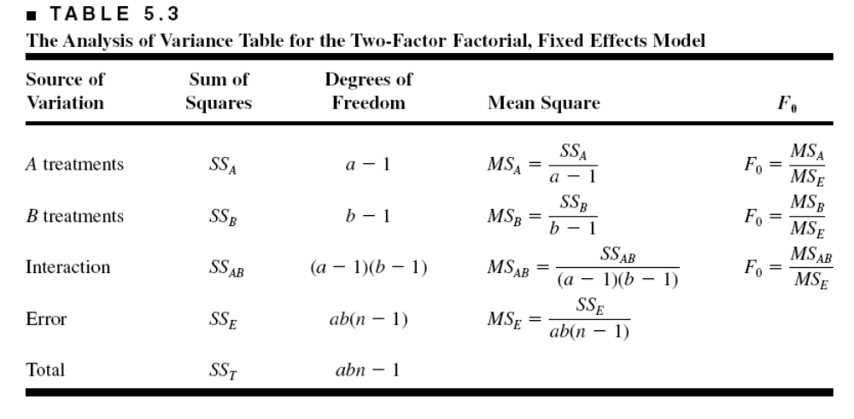
ANOVA Table – Fixed Effects Case
Design-Expert will perform the computations
Text gives details of manual computing (ugh!) – see pp. 171

Slide 12
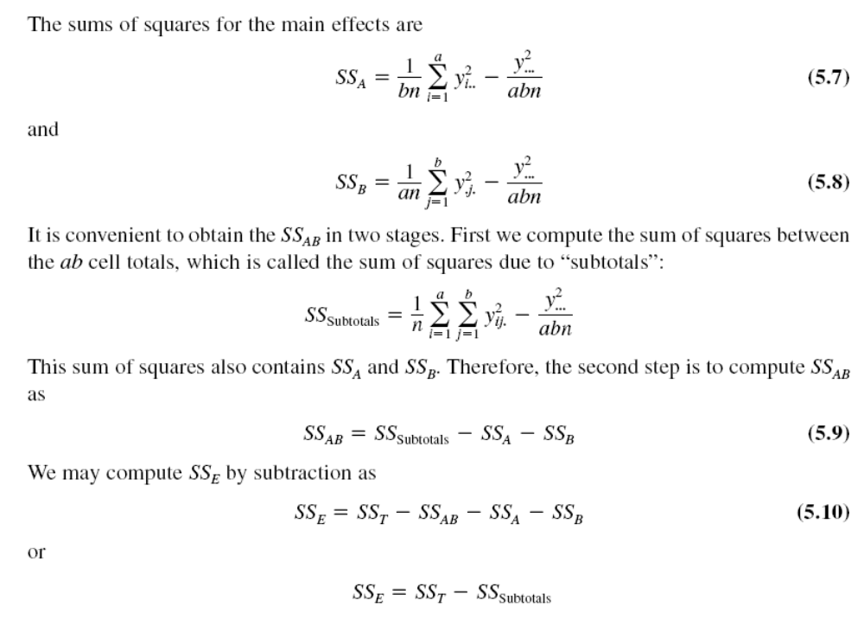

Slide 13
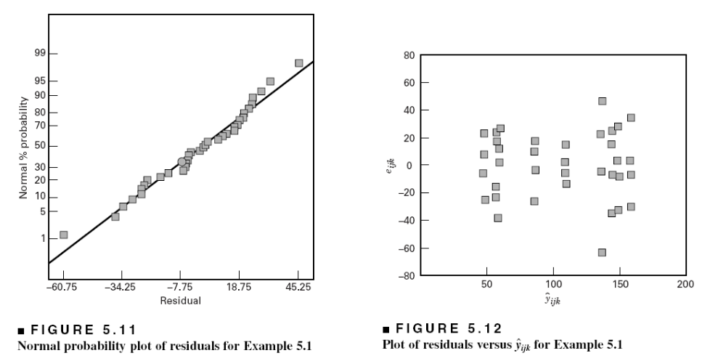
Residual Analysis – Example 5.1

Slide 14
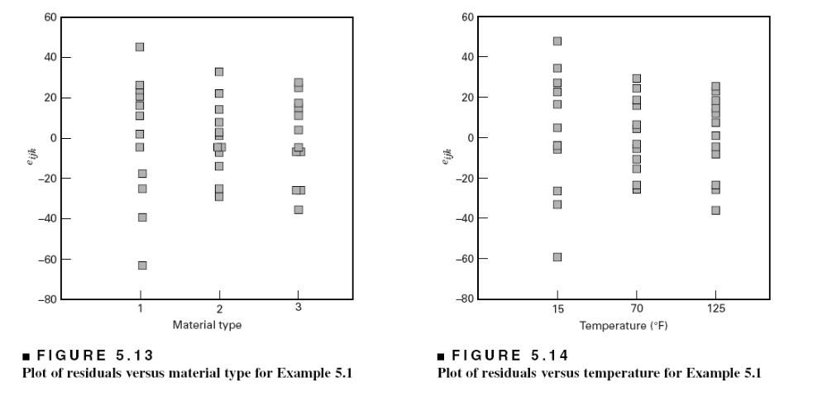
Residual Analysis – Example 5.1

Slide 15
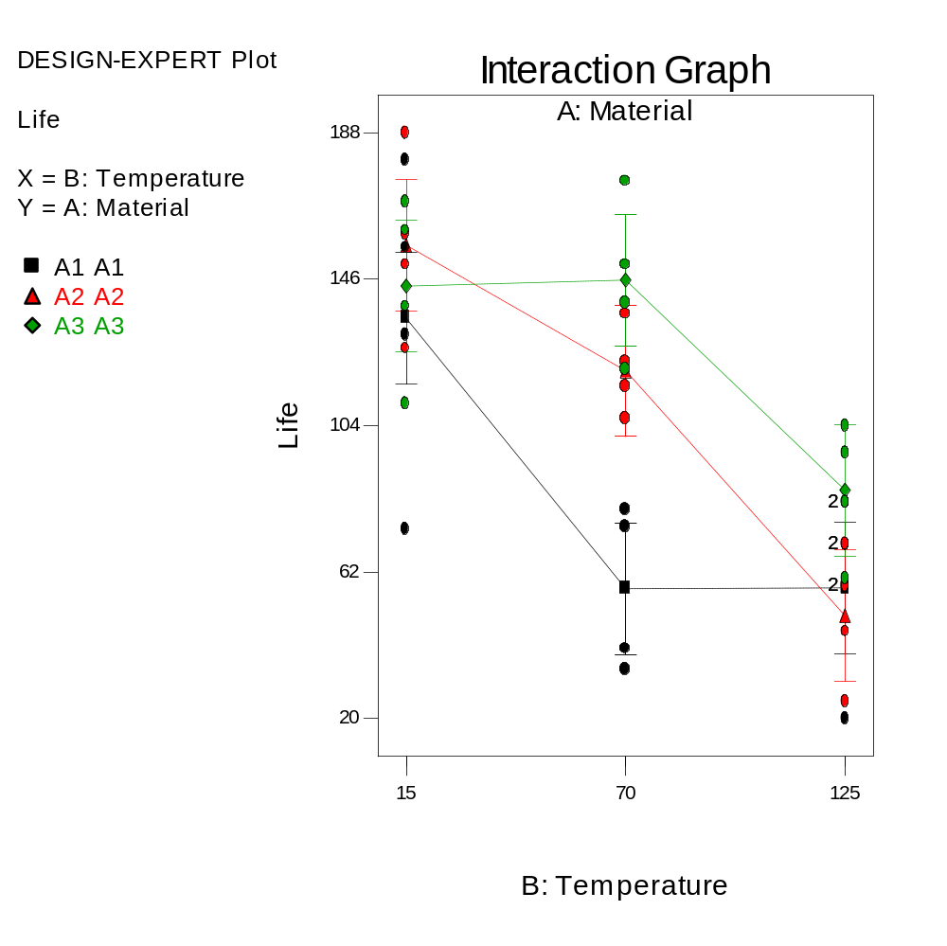
Interaction Plot

Slide 16
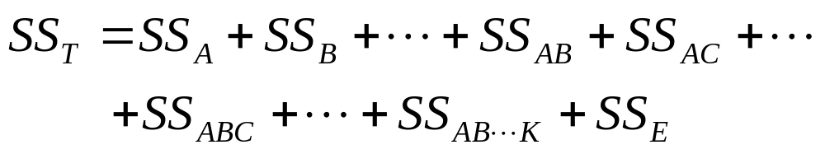
Factorials with More Than
Two Factors
Basic procedure is similar to the two-factor case; all abc…kn treatment combinations are run in random order
ANOVA identity is also similar:
Complete three-factor example in text, Example 5.5

